Slide 1

Design Patterns Observer, Singleton, & Adapter

Slide 2
Design Patterns
Template solutions to common problems
Oculus
Cupola
Pediment
Cornice
Columns
Portico

Slide 3
Iterative Development Process
Analysis
Design
Implementation
Requirements
Planning
Initial Planning
Testing
Evaluation
Deployment

Slide 4
This Lecture
Design patterns: what & why
When and how to apply
Several popular patterns:
Observer
Singleton
Adapter

Slide 5
Benefits
Avoid re-inventing solutions
Promotes quality
Reusability, maintainability, etc.
Facilitate communication
Good to know for interviews!

Slide 6
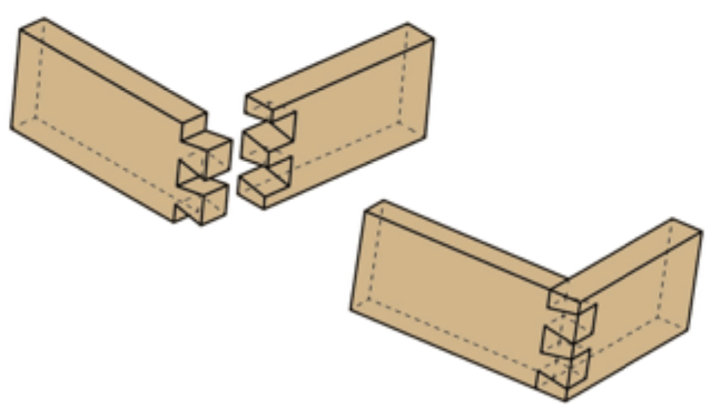
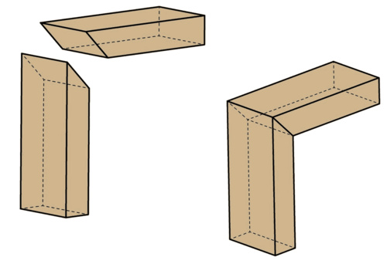
Woodworking example
“Do I need a dovetail joint or a miter joint?”
“Do I need to make a joint by cutting in by 45 degrees and then out 45 degrees…?”
Notes:
Example based on Michael Hilton’s CS361 lecture at CMU: http://www.cs.cmu.edu/~mhilton/classes/cs361/slides/11-DesignPatterns.pdf

Slide 7
Four pieces of a pattern
Pattern name
The problem the pattern solves
How to solve the problem
The consequences/constraints

Slide 8
Many patterns out there!
Notes:
23 original patterns in the GoF book

Slide 9
Features of a pattern from GoF
Name
Intent: What is the purpose?
Problem: What does it solve?
Solution: How do we approach the problem?
Participants: Who is involved?
Consequences: What is the effect of the pattern?
Implementation: Examples to implement Structure: Class diagram

Slide 10
Categories of patterns
Creational
How to create new instances
Structural
How to compose classes and objects
Behavioral
How objects interact and communicate

Slide 11
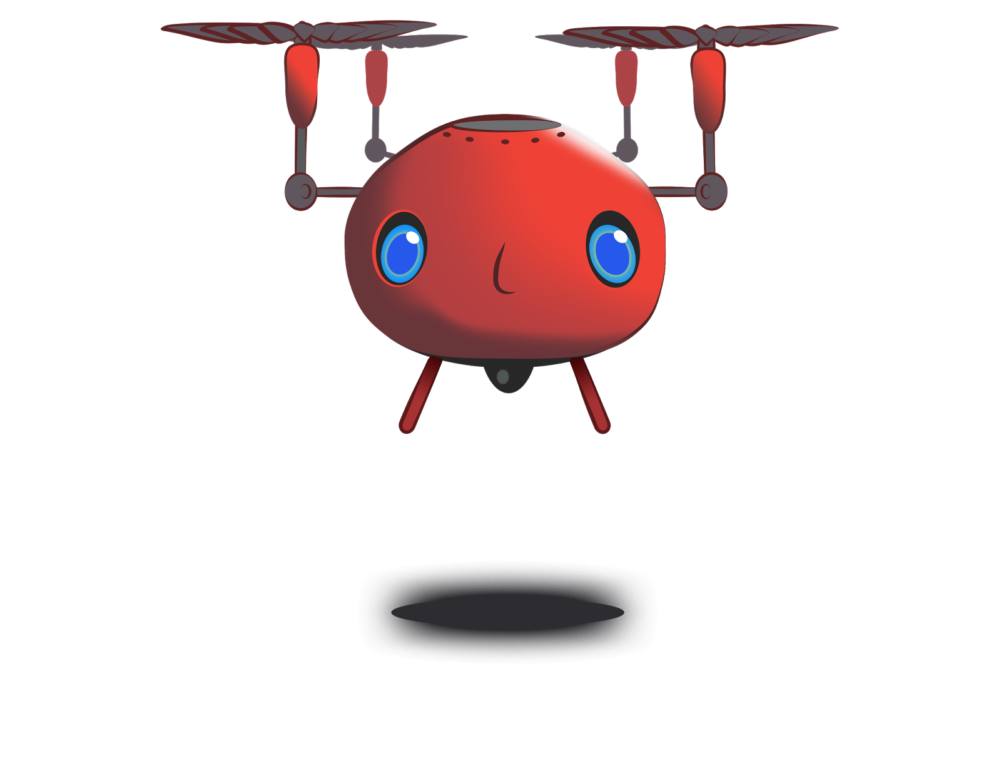

Running Example: Vols Dining
I'm hungry!
https://flic.kr/p/X6PBUC
Notes:
Vols Dining example is based off Scott Fleming’s Tiger Dining examples

Slide 12
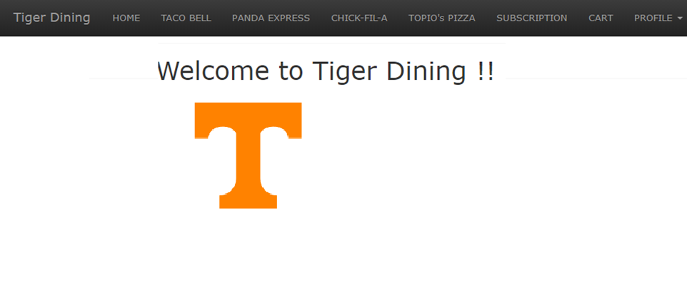
Vols Dining Web App
Vols Dining
Welcome to Vols Dining!

Slide 13
Vols Dining
Welcome to Vols Dining!

Slide 14
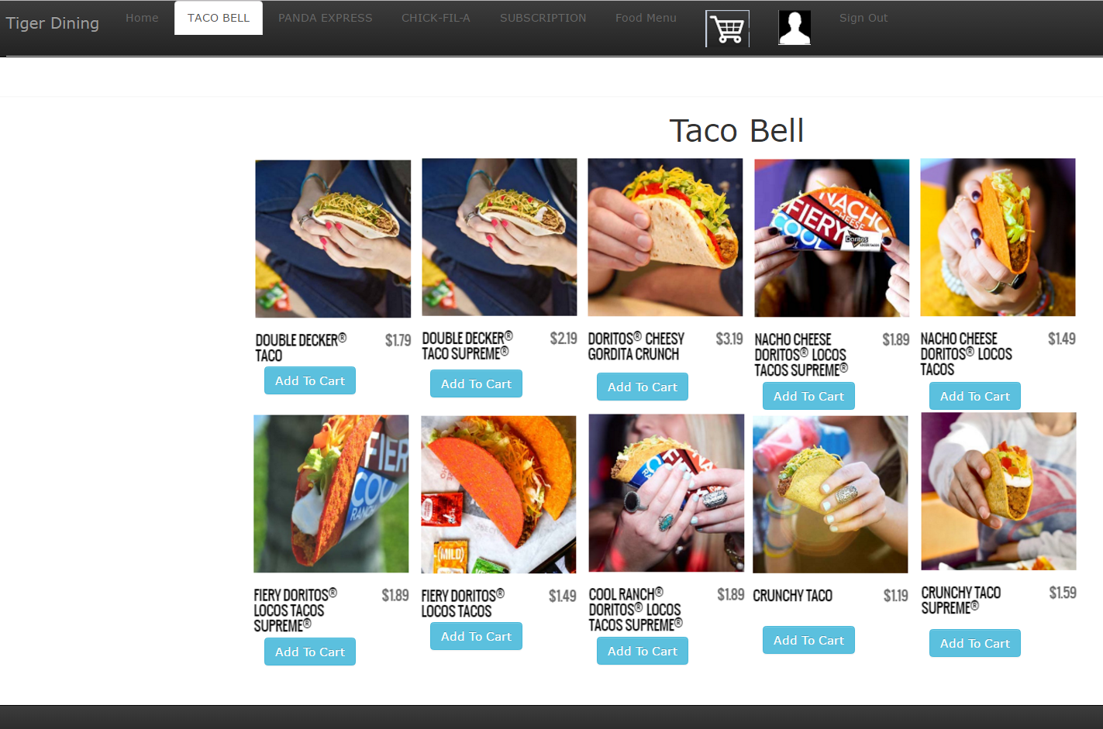
Vols Dining

Slide 15
Design Problem 1: Email Notifications

Slide 16
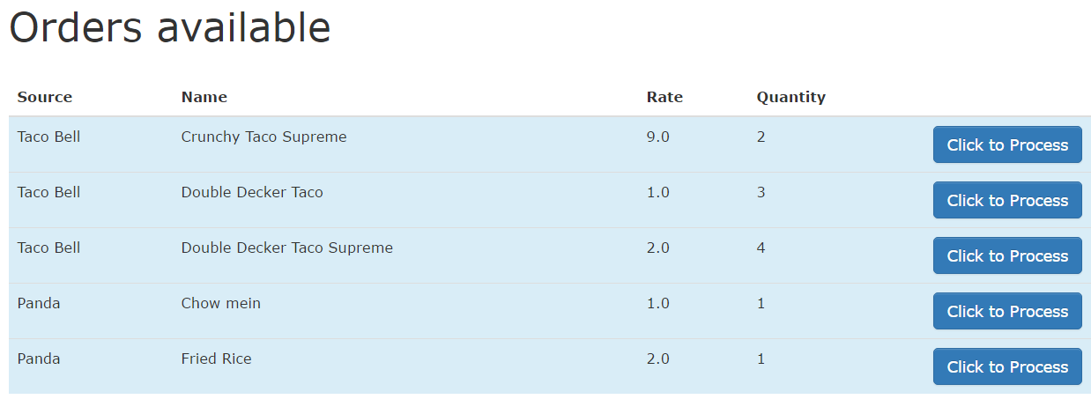
Chef’s View of Orders
Problem: Send email notifications as orders arrive
Notes:
When orders are placed they show up in the system like this.
Problem: The chef (and others) would like to receive email notifications to let them know when a new order has been placed. That way, they won't have to be constantly monitoring this webpage.

Slide 17
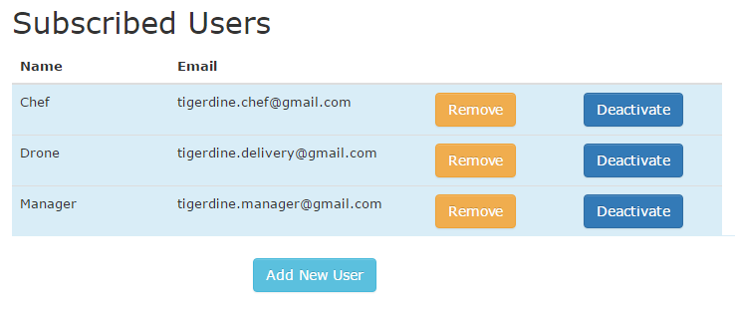
Existing Class: Subscribers List
Notes:
The system already has a subscription list of users who should receive email notifications (as shown in the picture).

Slide 18
Classes
?
OrdersController
...
create()
…
EmailNotifier
...
order_notification()
...

Slide 19
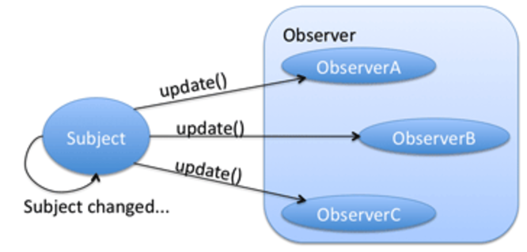
Solution: Observer Pattern
Notes:
Needs to add an observer for the food order activity
Define one-to-many dependency

Slide 20
Solution: Observer Pattern
From Gamma et al. Design Patterns: Elements of Reusable Object-Oriented Software
Notes:
Needs to add an observer for the food order activity
Define one-to-many dependency

Slide 21
Side Note: Lots of (Minor) Variations Exist for Design Patterns

Slide 22
Refactoring.Guru Variant
https://refactoring.guru/design-patterns/observer

Slide 23
Wikipedia Variant #1
Very similar to the GoF version
https://en.wikipedia.org/wiki/Observer_pattern

Slide 24
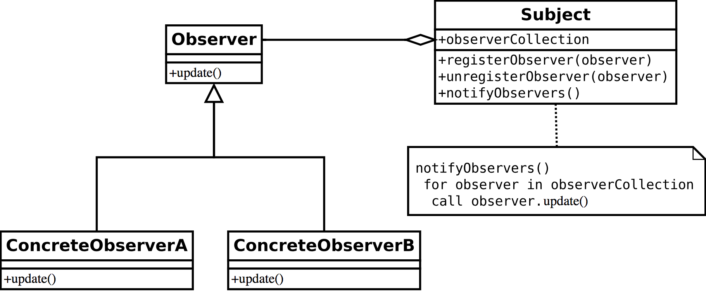
Wikipedia Variant #2
https://en.wikipedia.org/wiki/Observer_pattern

Slide 25
Application of Observer Pattern

Slide 26
Application of Observer Pattern
OrdersController
...
create()
…
EmailNotifier
...
order_notification()
...

Slide 27
Application of Observer Pattern
Subject
...
attach(observer)
detach(observer)
notify()
OrdersController
...
create()
…
EmailNotifier
...
order_notification()
...

Slide 28
Application of Observer Pattern
Subject
...
attach(observer)
detach(observer)
notify()
OrdersController
...
create()
…
EmailNotifier
...
order_notification()
...

Slide 29
Application of Observer Pattern
Subject
...
attach(observer)
detach(observer)
notify()
Observer
update()
OrdersController
...
create()
…
EmailNotifier
...
order_notification()
...

Slide 30
Application of Observer Pattern
Subject
...
attach(observer)
detach(observer)
notify()
Observer
update()
OrdersController
...
create()
…
EmailNotifier
...
order_notification()
...

Slide 31
Application of Observer Pattern
Subject
...
attach(observer)
detach(observer)
notify()
Observer
update()
OrdersController
...
create()
…
EmailNotifier
...
order_notification()
update()
...

Slide 32
Application of Observer Pattern
Subject
...
attach(observer)
detach(observer)
notify()
*
observer
Observer
update()
OrdersController
...
create()
…
EmailNotifier
...
order_notification()
update()
...

Slide 33
Application of Observer Pattern
Subject
...
attach(observer)
detach(observer)
notify()
*
observer
Observer
update()
OrdersController
...
create()
…
EmailNotifier
...
order_notification()
update()
...
subject

Slide 34
Application of Observer Pattern
Subject
...
attach(observer)
detach(observer)
notify()
*
observer
Observer
update()
OrdersController
...
create()
…
EmailNotifier
...
order_notification()
update()
...
subject

Slide 35
Scenario: Create Order and Send Email
: OrdersController
: EmailNotifier
create()
<<create>>
: Order
save()
Saved to DB
notify_observers()
update()
Email Sent

Slide 36
How to Apply Observer Pattern
Modify OrdersController (Subject)
implement Observable
Add observer using add_observer()
After saving order, call notify_observers()
Modify EmailNotifier (Observer)
implement Observer
Add update method that…
Notes:
Add code snippet

Slide 37
Other Examples
Spreadsheet
Employee payroll
GUI program (callback)

Slide 38
Design problem:
Sales Logging

Slide 39
Problem
Saves records of transactions as backup
Sales logging for transaction failure

Slide 40
Existing Class
SalesLogger
initialize(file)
formatter
log(message)

Slide 41
Solution: Singleton Pattern
From Gamma et al. Design Patterns: Elements of Reusable Object-Oriented Software

Slide 42
Application of Singleton Pattern
SalesLogger
inst : SalesLogger
initialize(file)
formatter
log(message)
instance() : SalesLogger

Slide 43
Solution: Singleton
Single file to log all the sales information
Easy to look up
Singleton
inst: Singleton
instance(): Singleton
…
if inst == nil
inst = Singleton.new
end
return inst

Slide 44
Implementing a Singleton
Ensure only one instance exists
Global access to instance
No inheritance, just modify the class
Static instance
Check if exists, if it does, return instance
If does not exist, create it and return instance
Private constructor

Slide 45
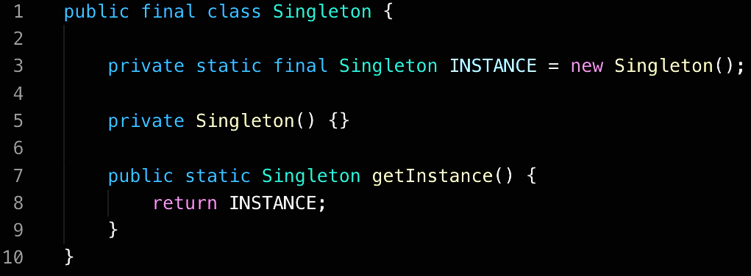
Java Implementation

Slide 46
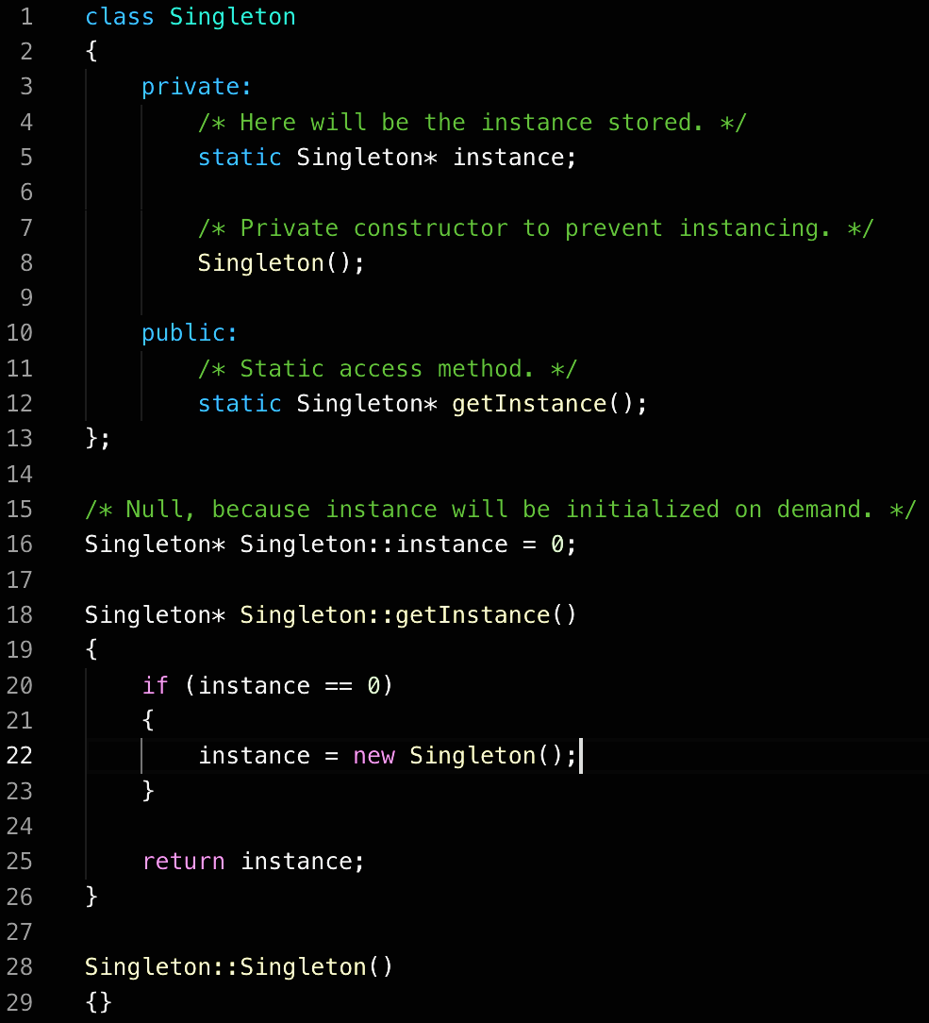
C++ Implementation

Slide 47
Design problem:
New Payment method

Slide 48
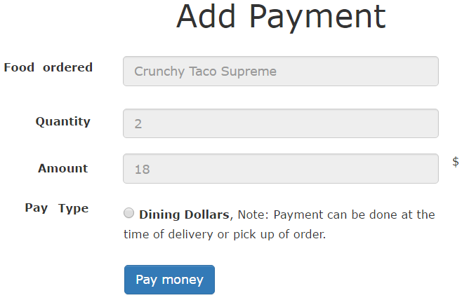
Goal: To Add Visa Debit Card and Paypal

Slide 49
Goal: To add VisaPay
PaymentsController
new
create
…
DiningDollars
charge(uid)
…

Slide 50
Solution: Adapter
Interface which bridge a gap in payment methods
Key objects are Target, Adapter and Adaptee
Client
Target
Request()
Adapter
Request()
Adaptee
SpecificRequest()

Slide 51
PaymentsController
PaymentProcessor
process_payment()
DiningDollarsAdapter
process_payment()
VisaPayAdapter
process_payment()
…
…
DiningDollars
charge(uid)
VisaPay
pay(debitcard, cvv, exp)
…
…
Notes:
**PICK UP HERE

Slide 52
Control Flow
PaymentsController
VisaPayAdapter
VisaPay
create
process_payment
pay
Visa processes the payment

Slide 53
Goal: Implement Adapter Pattern
PaymentsController
“create” method call the adapter based on the input type
VisaPayAdapter
defines “process_payments” inherited from the PaymentProcessor
VisaPay
defines pay(creditcard, cvv, exp) saves the information

Slide 54
Benefits of the Adapter pattern
Bridges classes that can’t work together
Easy to code: wraps existing class with a new class
Enables code reuse

Slide 55
Summary
Singleton:
Making Sure There Is Only one
Observer:
Keeping Up with the Times
Adapter:
Filling the gaps

